Slide 1
AAUP Financial Review
Delaware Valley University
Bonnie Fox Garrity, EdD, MBA, MA

Slide 2
Agenda
Enrollment trends
Endowment assets
Revenue sources
Change in net assets
Bond rating outlook
Budget
Salary spending
Inflation: effect on faculty salaries
Salary comparisons
The business case

Slide 3
Faculty Challenges
Inflation erosion of buying power of faculty salaries
Recent reductions in professional development funding with the apparent expectation that faculty members will self-fund important activities that impact their teaching and students, along with their own evaluation, promotion, and tenure
Students who bring differing levels of preparation due to Covid-disrupted previous learning experiences
Finding the correct balance between being flexible to accommodate students and maintaining high standards to encourage student achievement
Students who have more behavioral health awareness, needs, and accommodation requests in the classroom
Inadequate institutional support systems such as infrastructure and technology to assist with student accommodations
Creating and maintaining online support materials in learning management systems: a time-consuming task

Slide 4
Enrollment

Slide 5
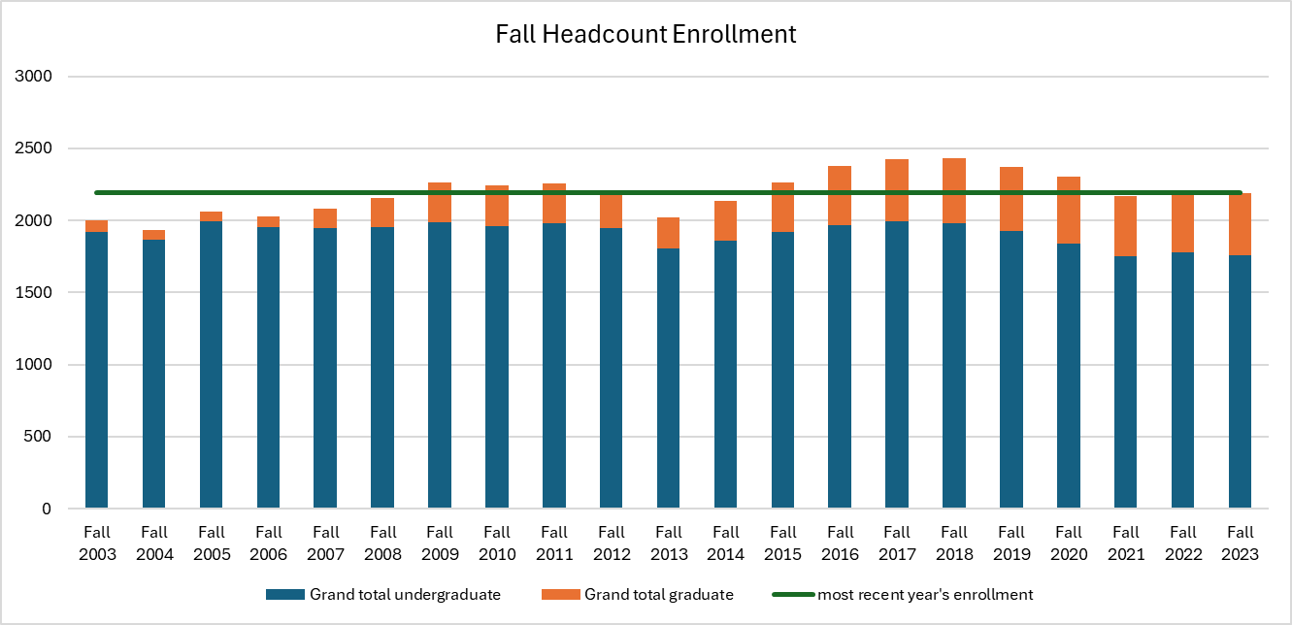
Delaware Valley Enrollment - IPEDS

Slide 6
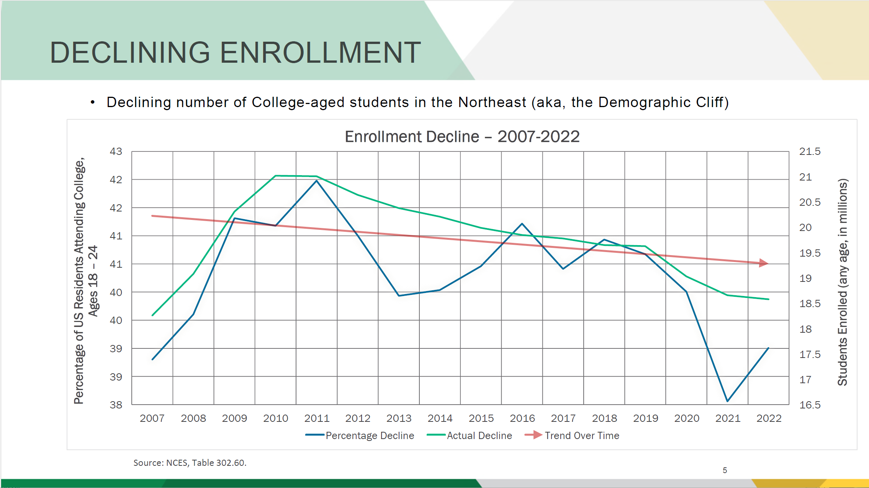

Slide 7
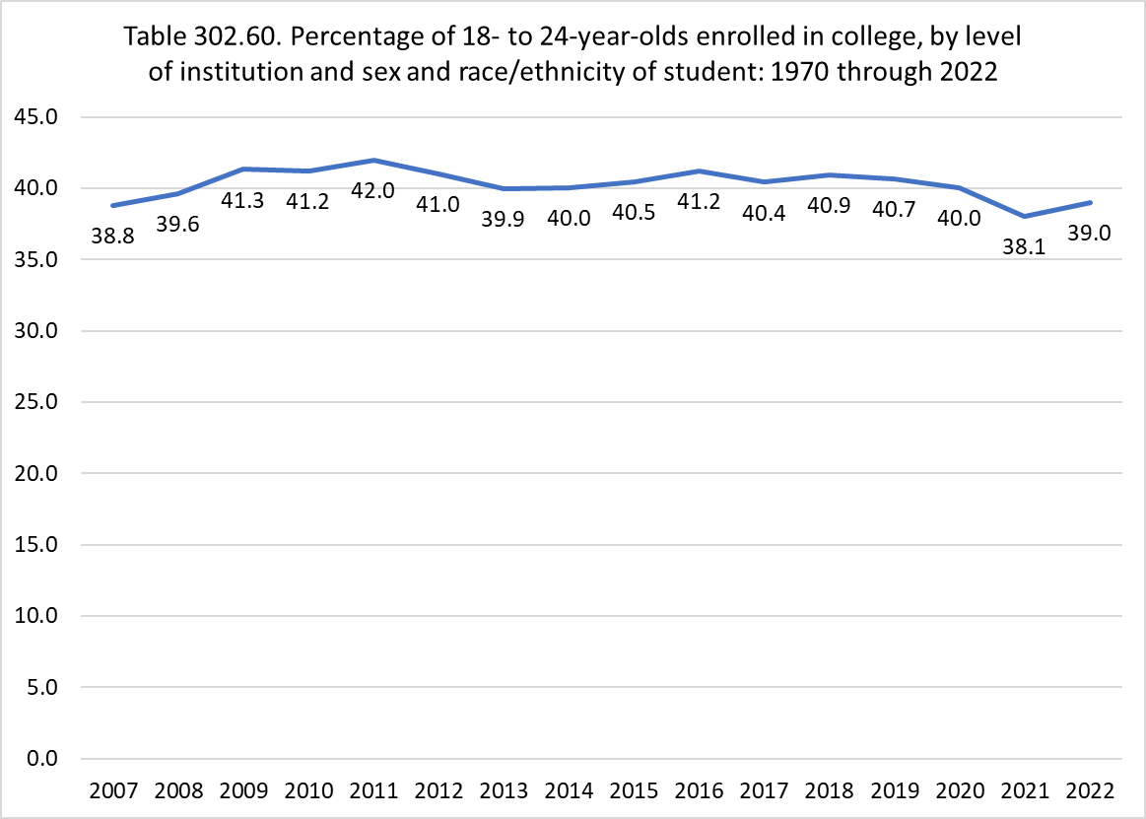

Slide 8
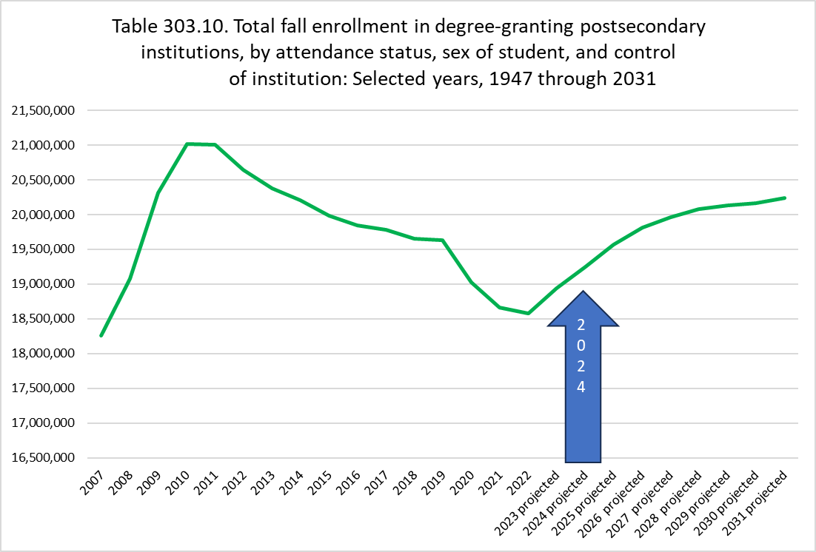

Slide 9
Endowment Assets

Slide 10
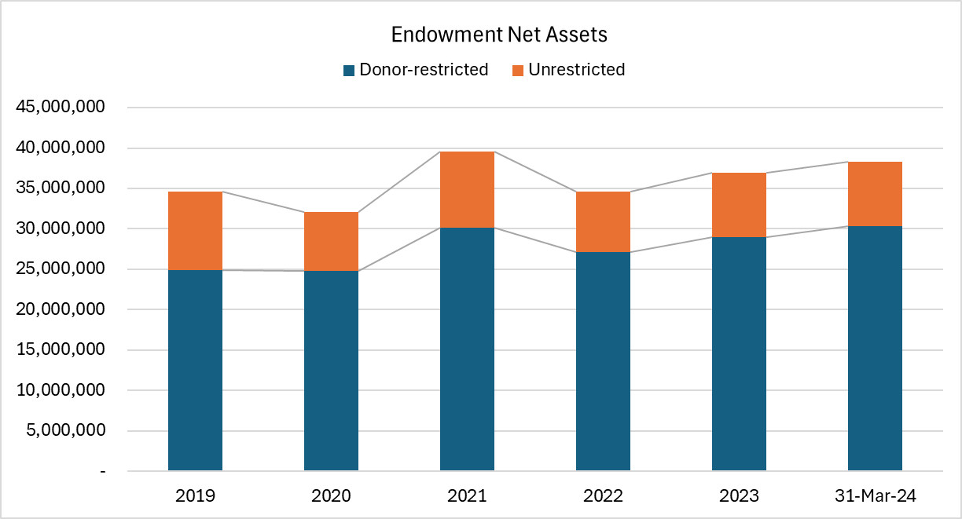
Endowment Net Assets
(SOURCE: Audited financial statements and DVU presentation)

Slide 11
Revenue Sources

Slide 12
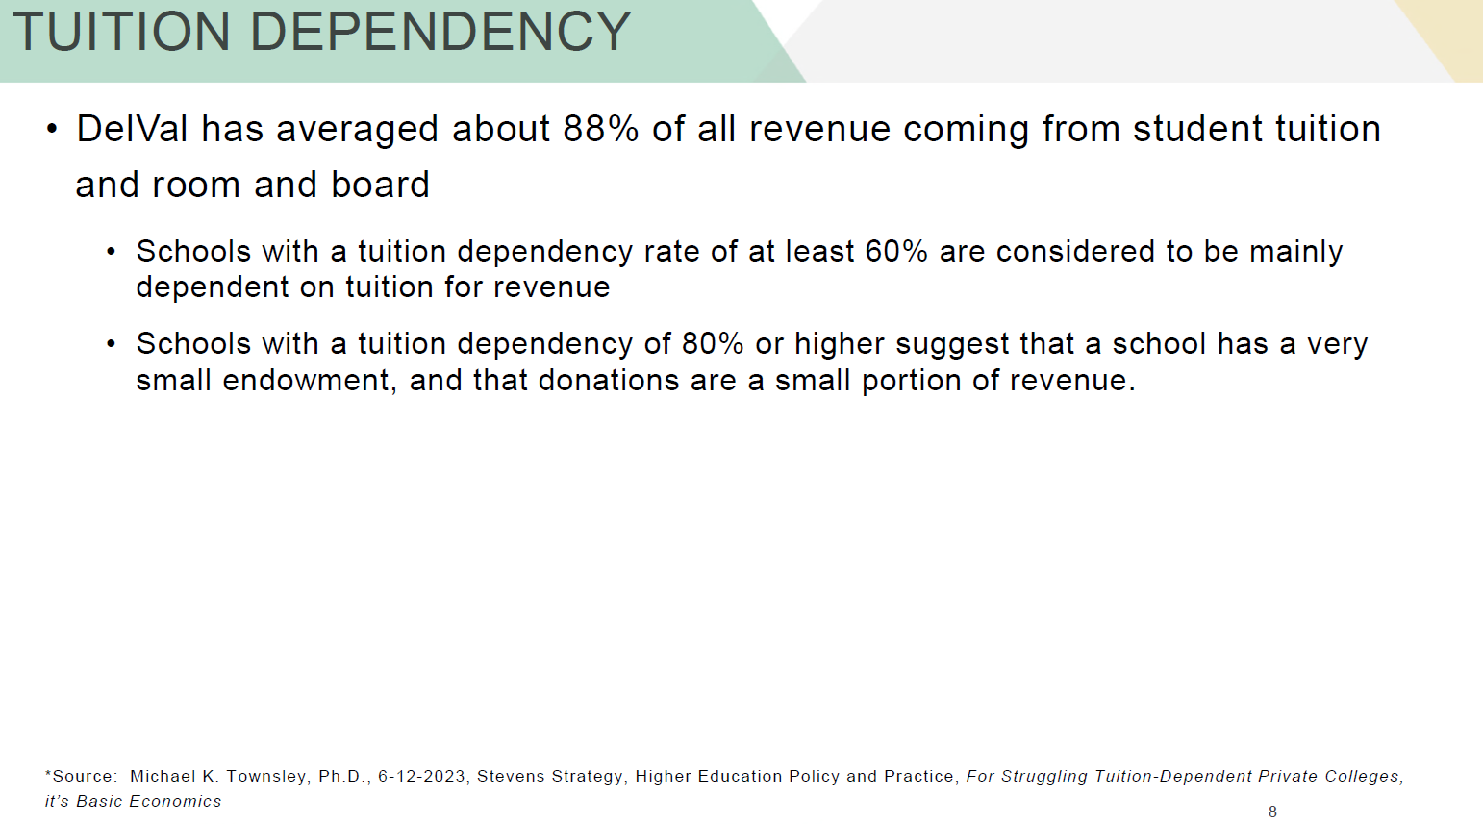
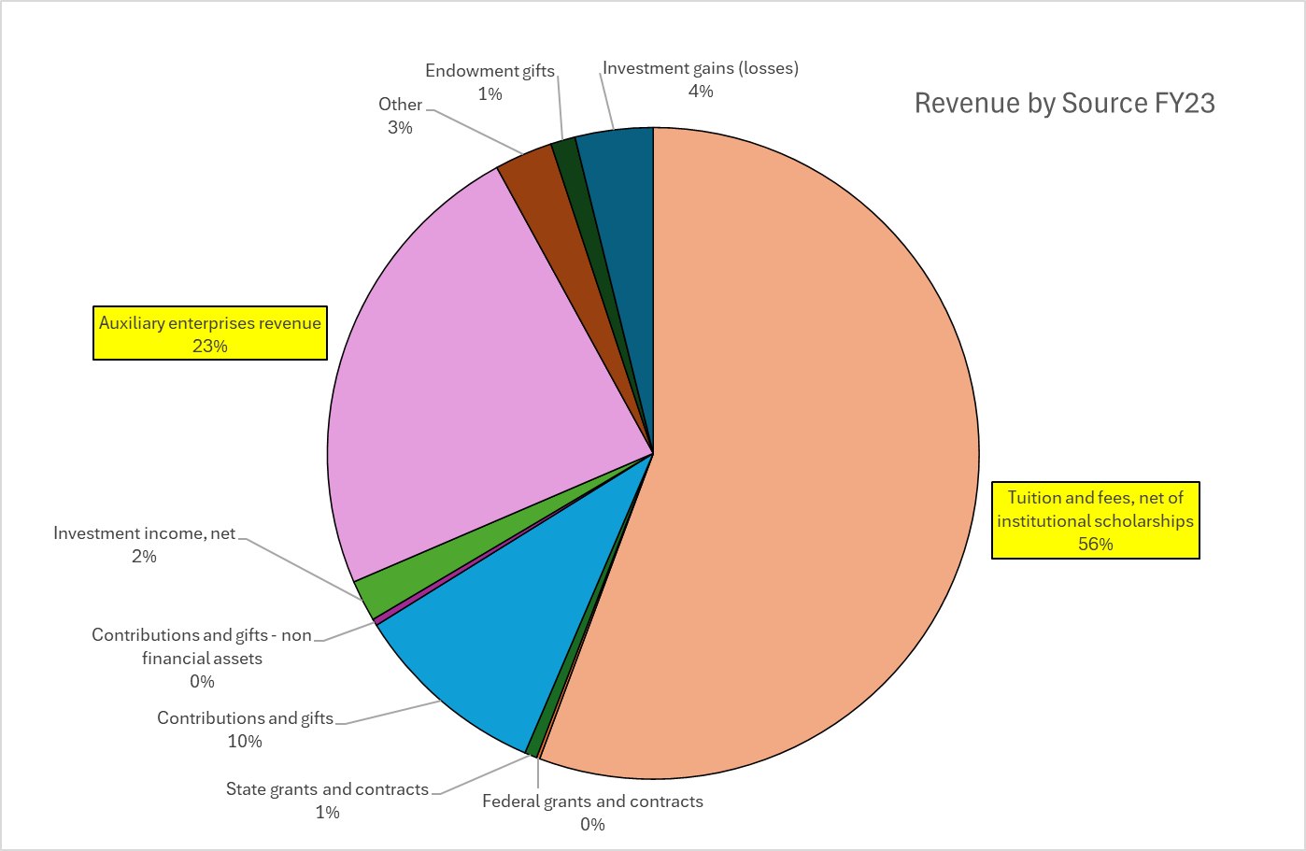
DelVal Revenue from the Audited Financial Statements
79% of total revenue reported on the audited financial statements in FY23 was from auxiliary enterprises and tuition and fees
Extremely important to invest in the education of students since this is the main source of revenue

Slide 13
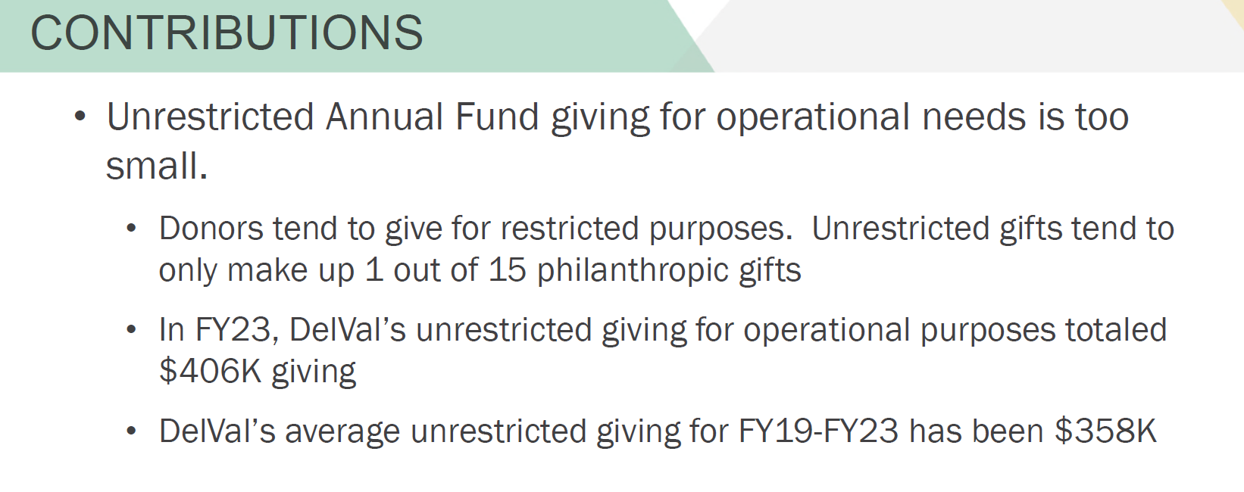
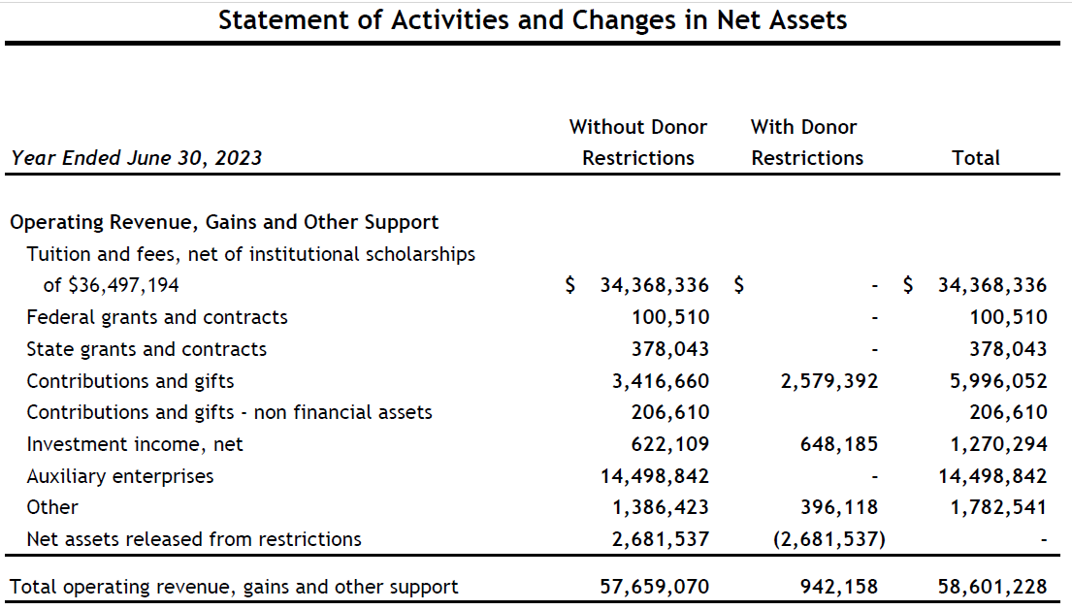
FY23 Delaware Valley Audited Financial Statements

Slide 14
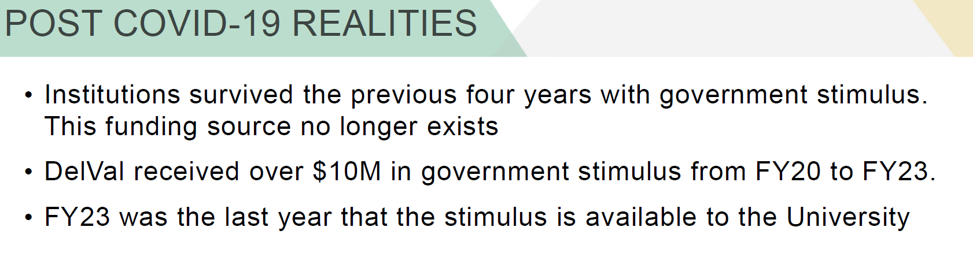

Slide 15
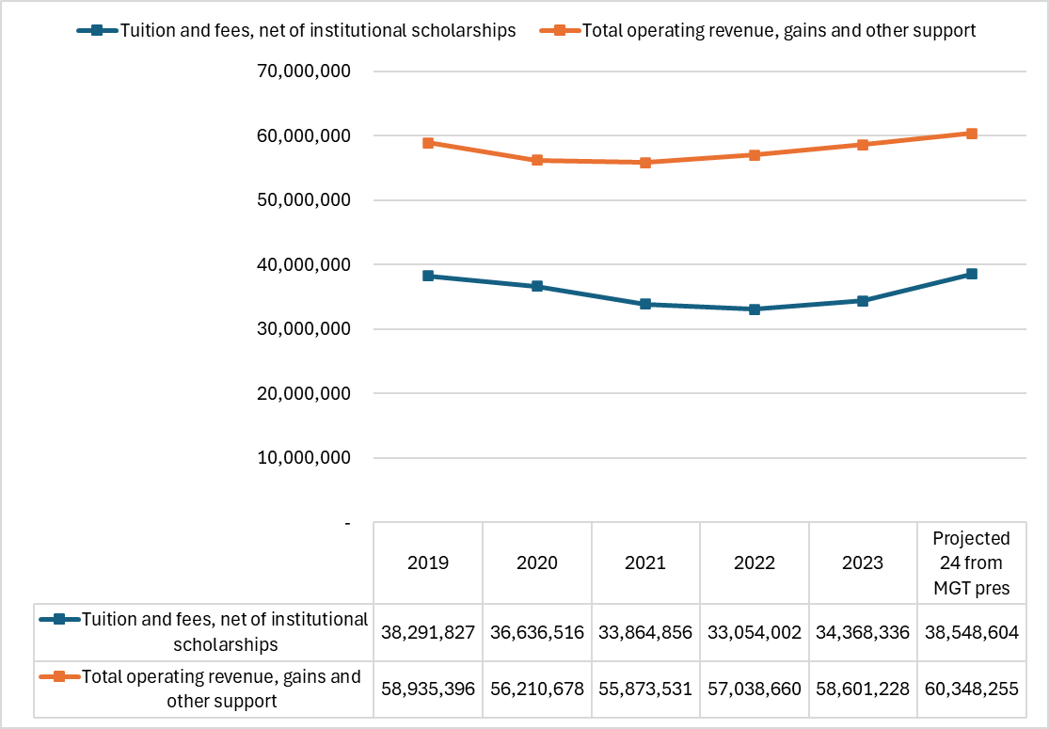

Slide 16
Change in Net Assets

Slide 17
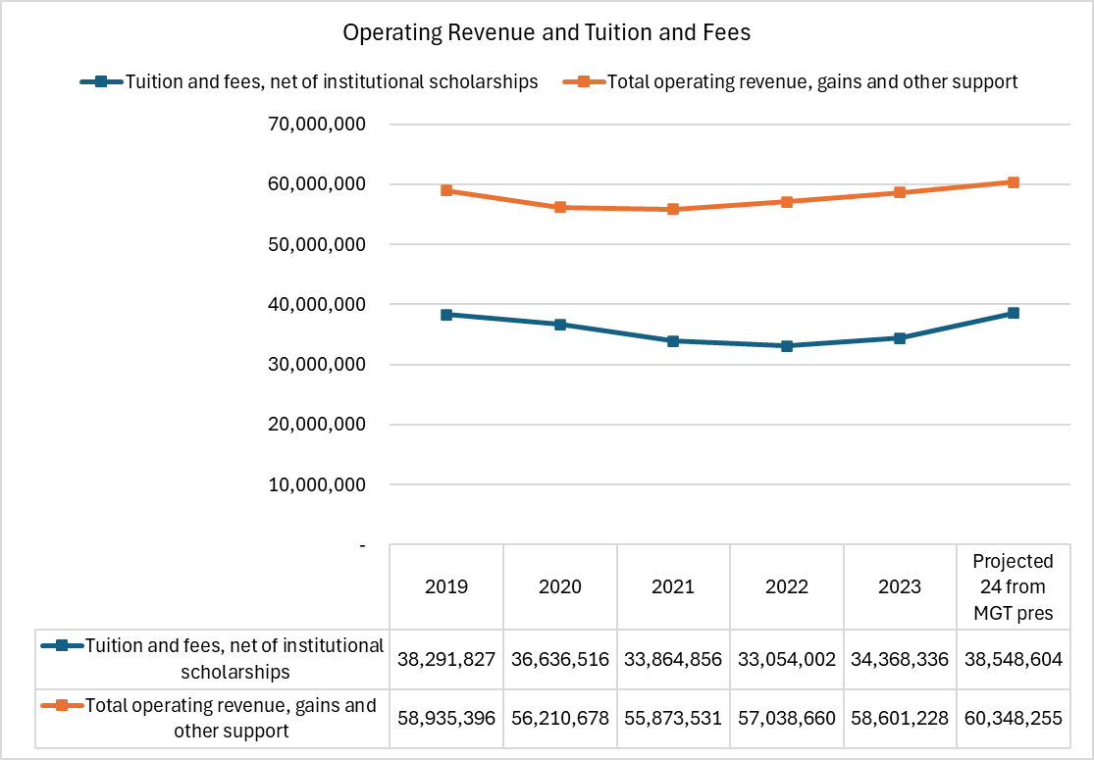
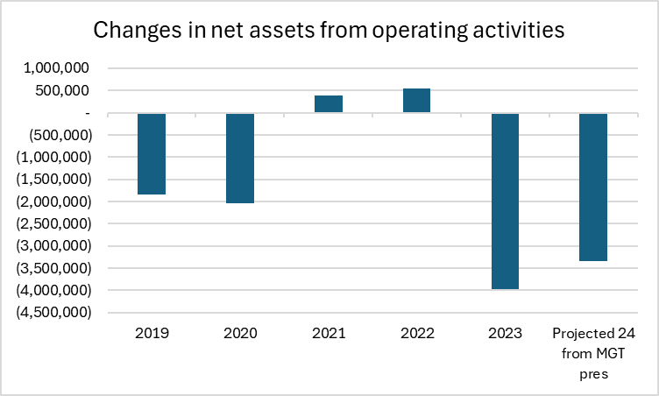
Increasing tuition and fees and operating revenue, continued negative change in net assets from operations

Slide 18
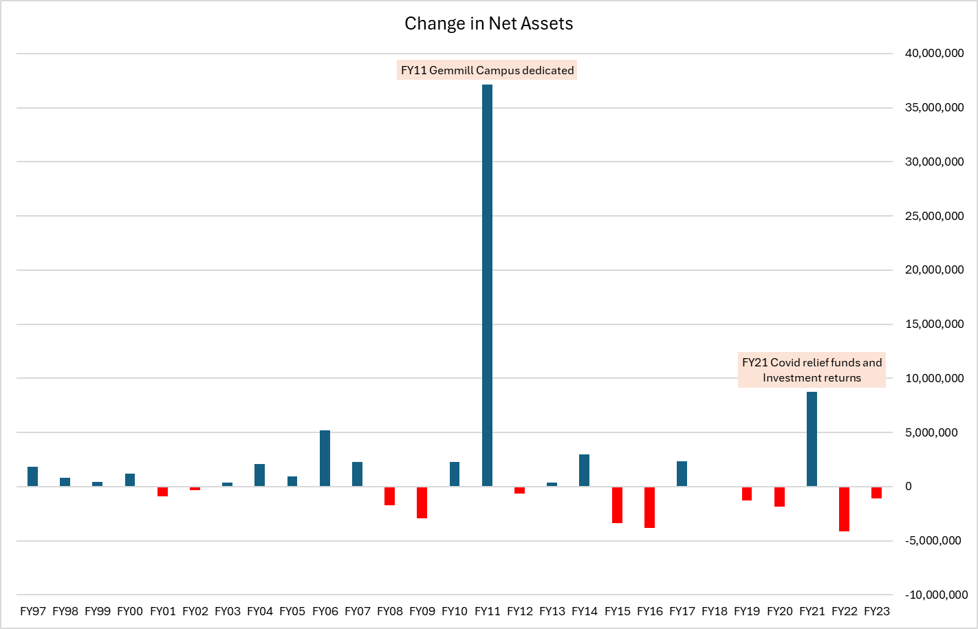
12 of the past 23 years have resulted in a negative change in net assets

Slide 19
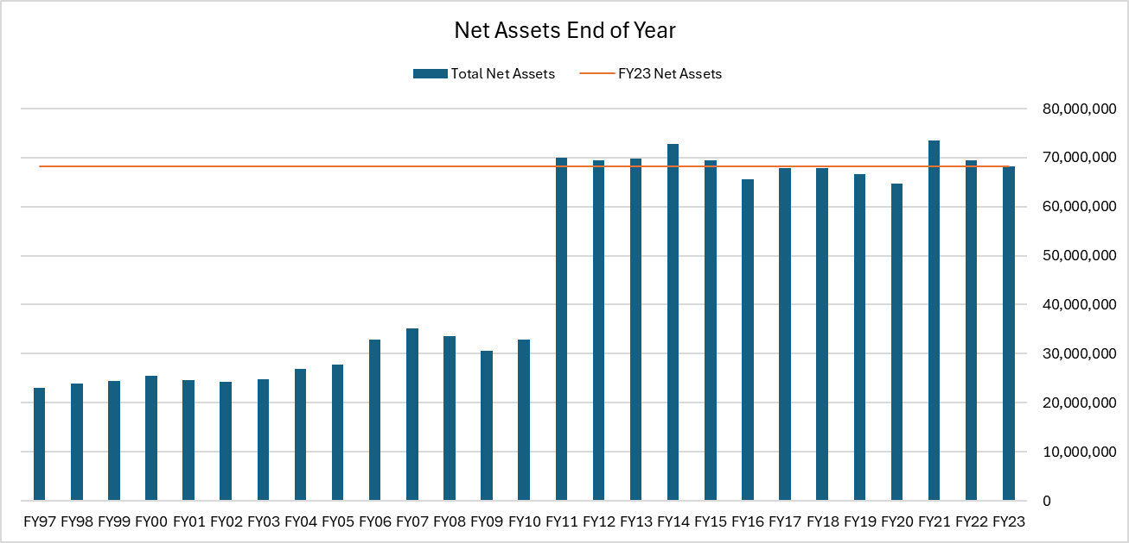
Net assets cyclical pattern over time

Slide 20
Bond Rating Outlook

Slide 21
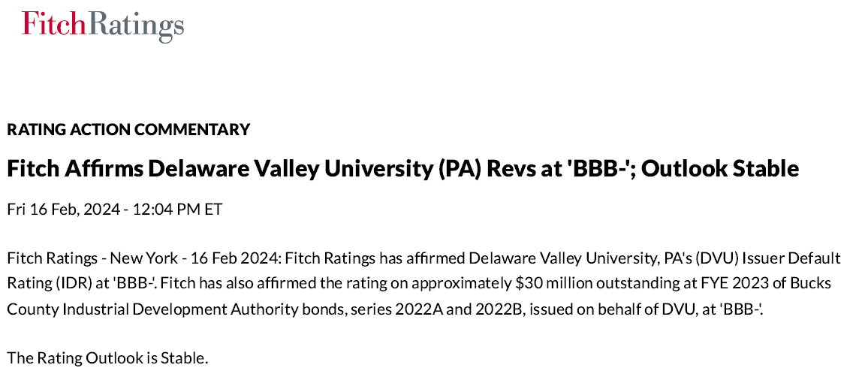
“Outlooks indicate the direction a rating is likely to move over a one- to two-year period” – Fitchratings.com

Slide 22
Budget

Slide 23
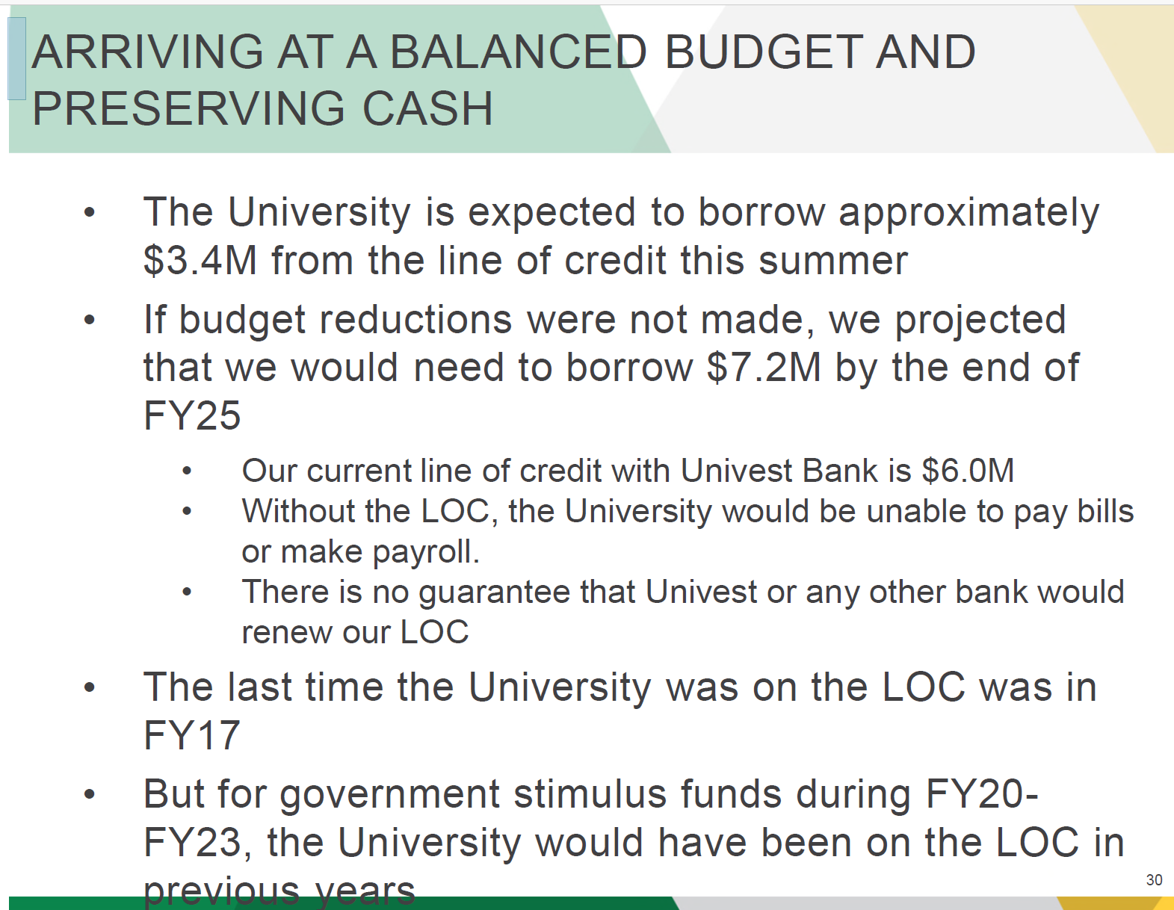
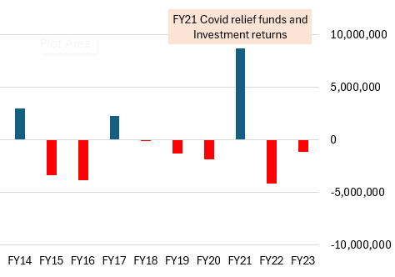
The last time the University was on the LOC was in FY17.
FY17 ended with $2.3 million positive change in net assets, one of the better financial years in recent history.

Slide 24
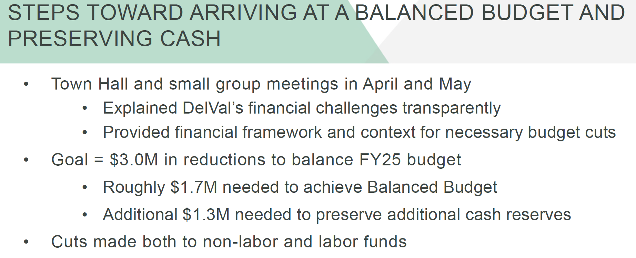

Slide 25
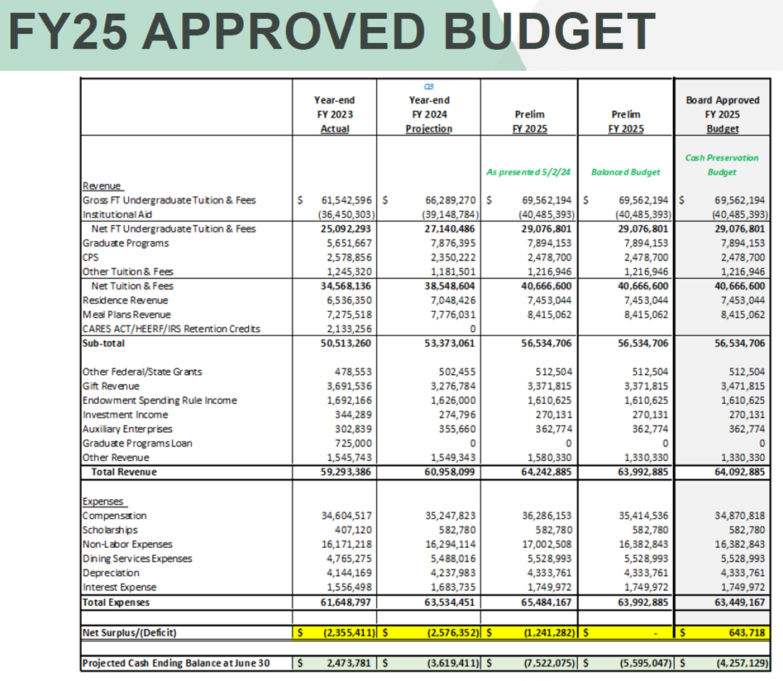
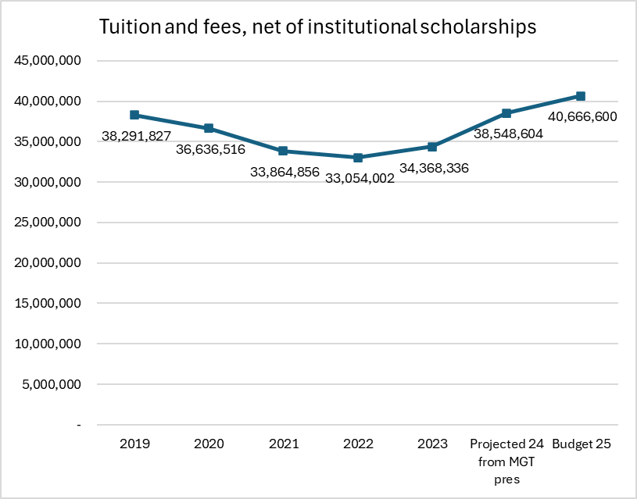
Net tuition and fees increased 12.16% from FY23 to FY24. The projected increase in the FY25 budget is only 5.5%.
Source: audited financial statements and administration presentation

Slide 26
Spending on Salaries

Slide 27
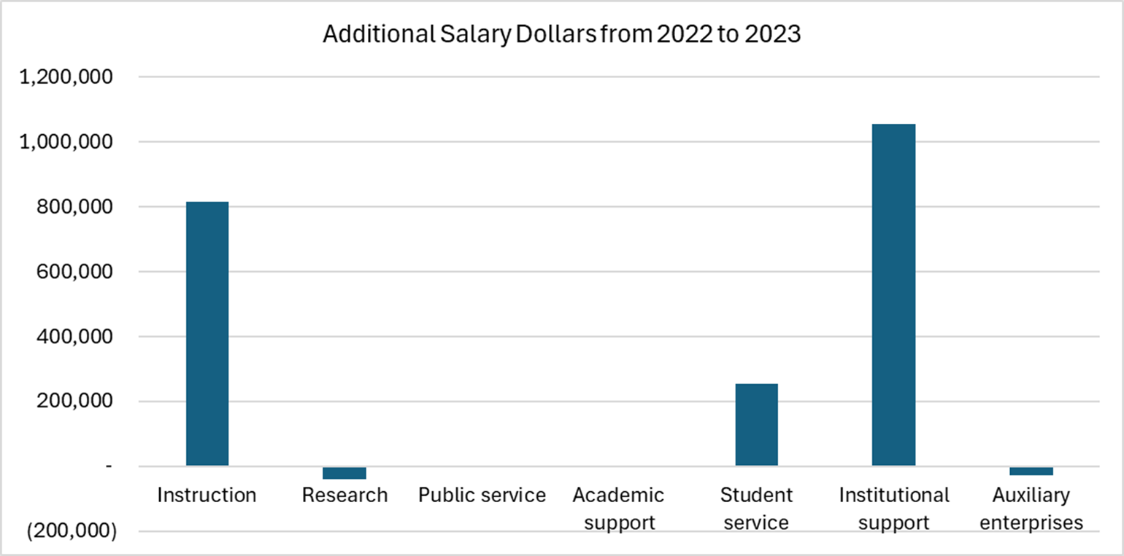
The change in salary dollars by functional area
(full-time and part-time employees)
Source: IPEDS

Slide 28
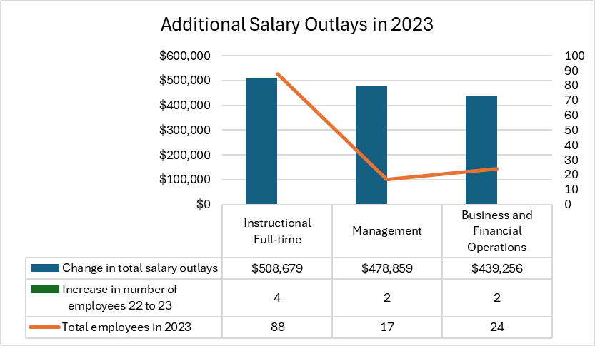
Change in Salary Outlays for Full-time Employees
Source: IPEDS

Slide 29
Inflation: effect on faculty salaries

Slide 30
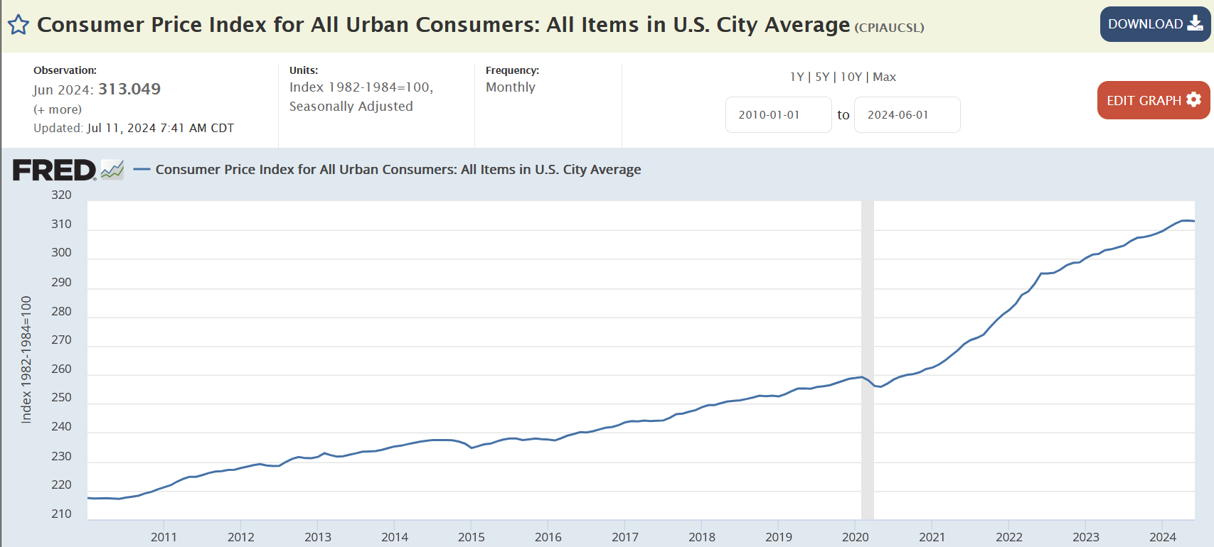
Inflation
SOURCE: Federal Reserve Bank of St. Louis https://fred.stlouisfed.org/series/CPIAUCSL

Slide 31
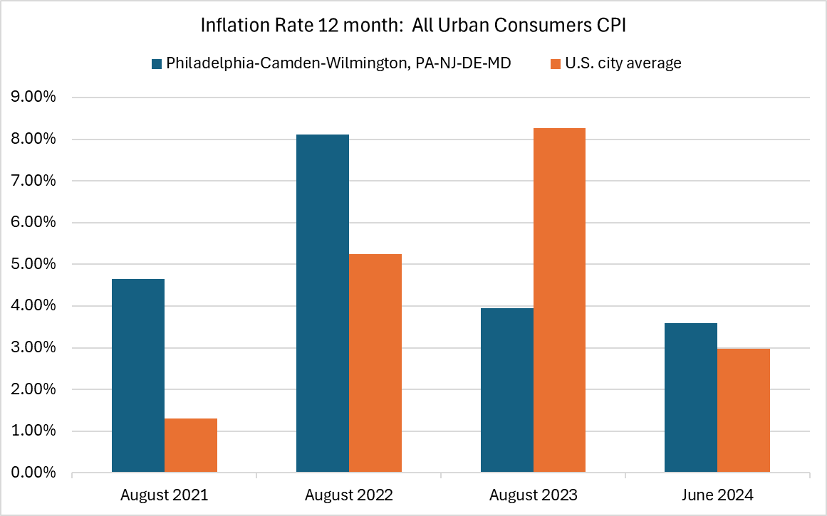
Inflation rate in the Philadelphia-Camden-Wilmington area
Source: US Bureau of Labor Statistics

Slide 32
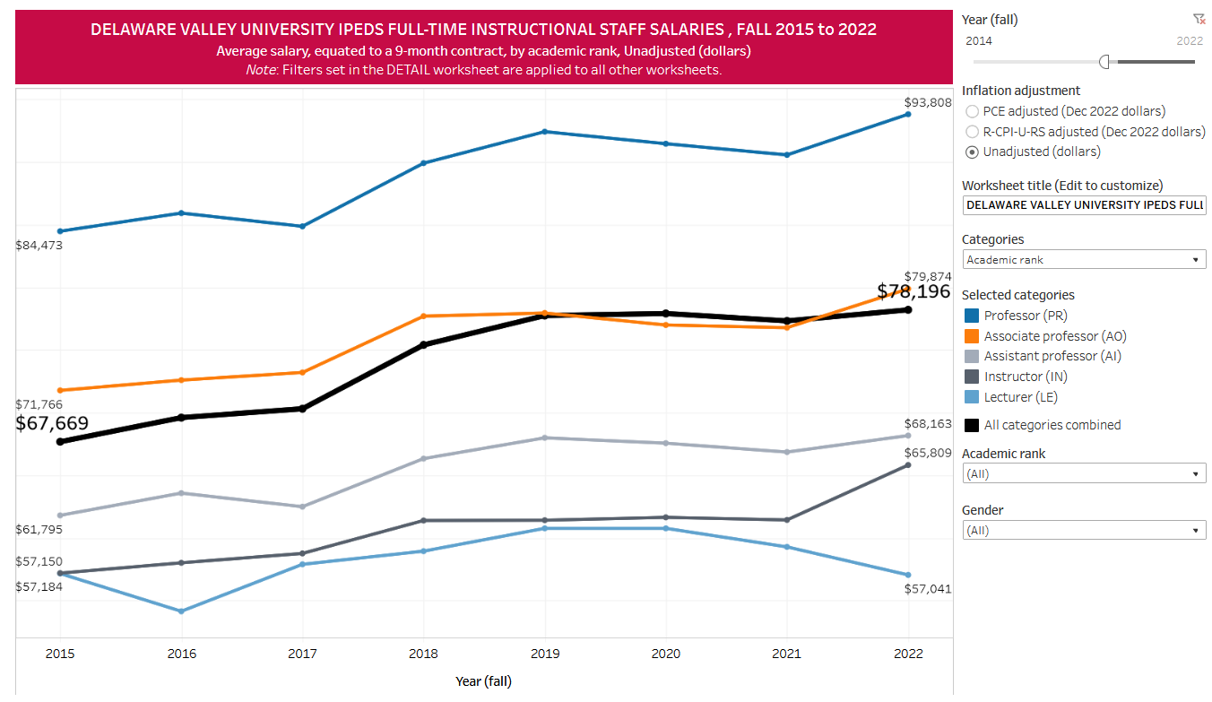
Average faculty salaries at Delaware Valley
Fall 2015 to 2022
Source: IPEDS data

Slide 33
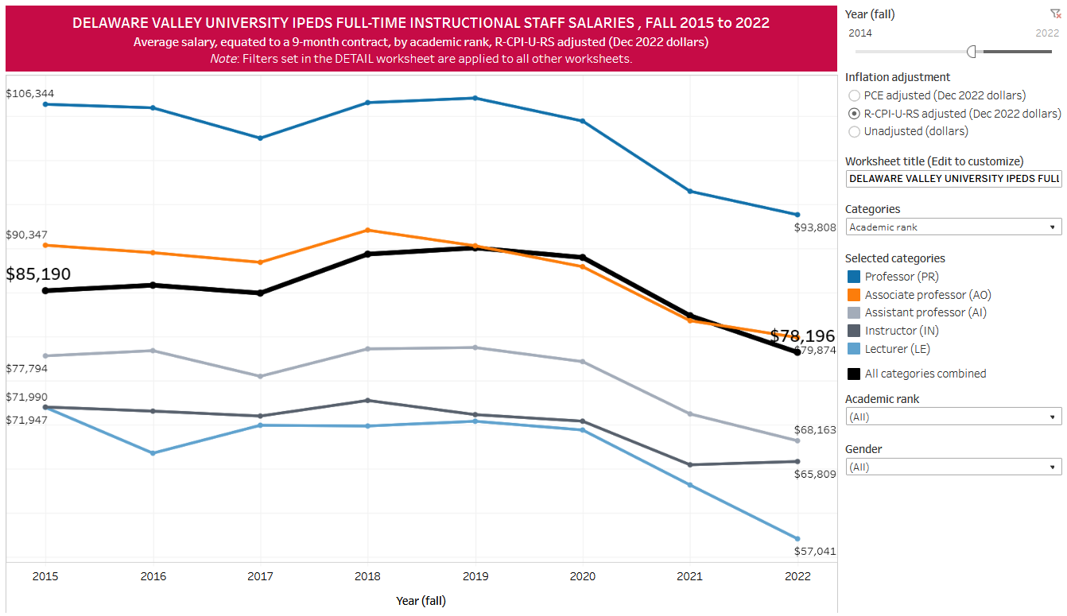
Inflation adjusted average faculty salaries
Fall 2015 to 2022
Source: IPEDS data

Slide 34
Salary comparisons

Slide 35
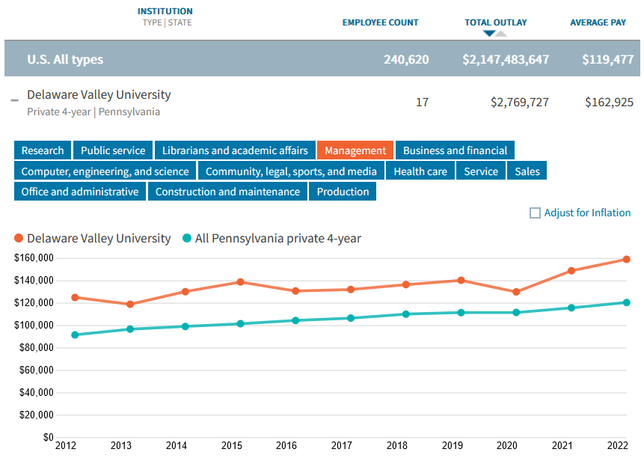
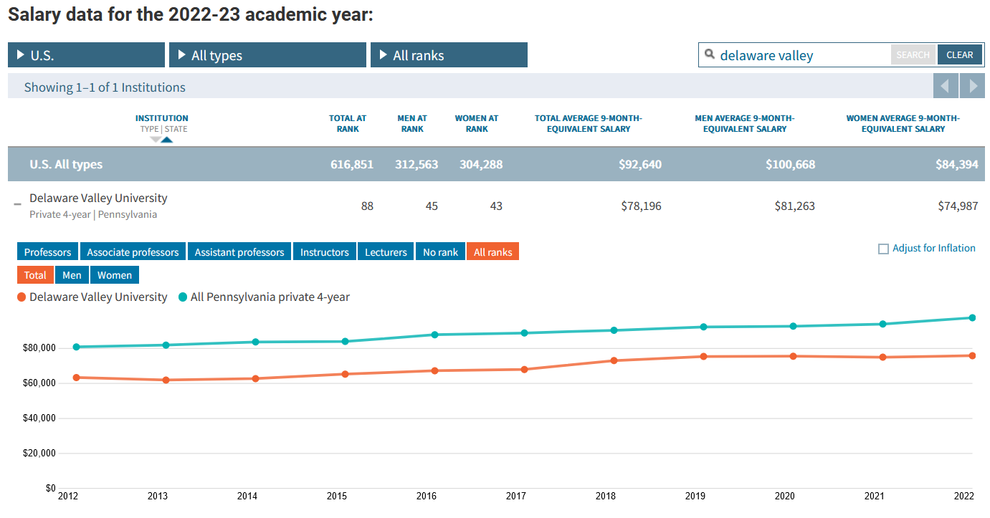
Mean Salaries Compared to Private, 4-year in PA
Management
Faculty
2022 mean
PA, 4-year private $124,381
DelVal: $162,925
2022 mean
PA, 4-year private $99,901
DelVal: $78,196
Source: The Chronicle of Higher Education using IPEDS reported data faculty and management

Slide 36
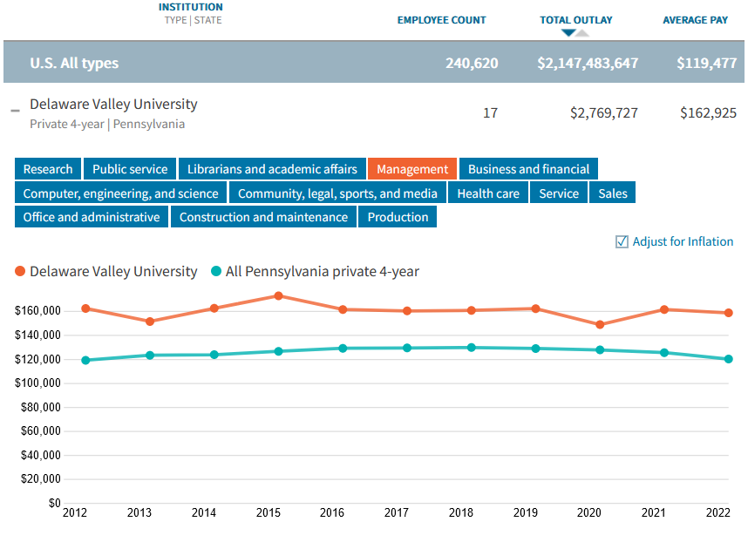
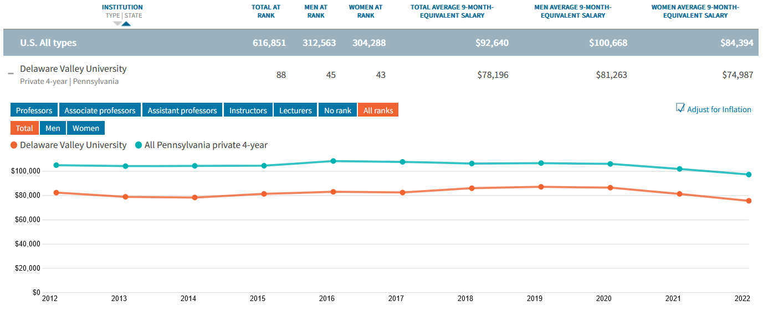
Inflation Adjusted Mean Salaries Compared to Private, 4-year in PA
Mean DelVal management salary inflation adjusted:
2012 $166,686
2022 $162,925
Decline of 2.26%
Mean DelVal faculty salary inflation adjusted:
2012 $84,975
$78,196
Decline of 7.98%
Source: The Chronicle of Higher Education using IPEDS reported data faculty and administration

Slide 37
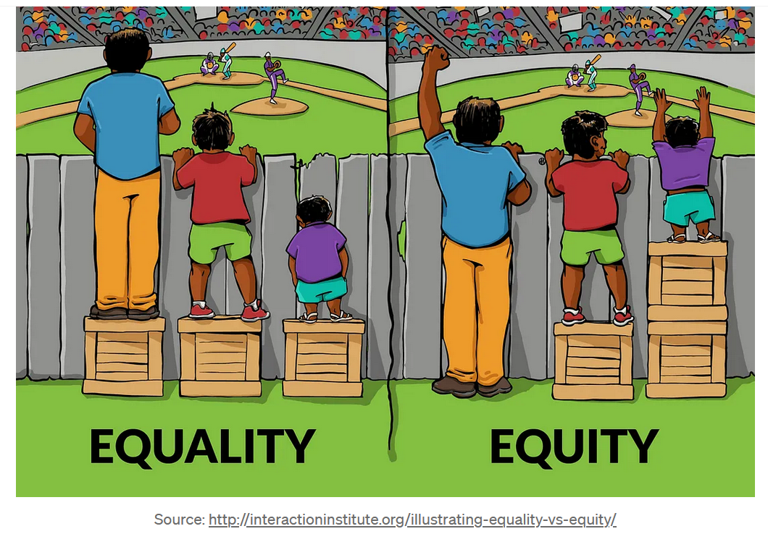

Slide 38
The Business Case

Slide 39
$82,465

Slide 40
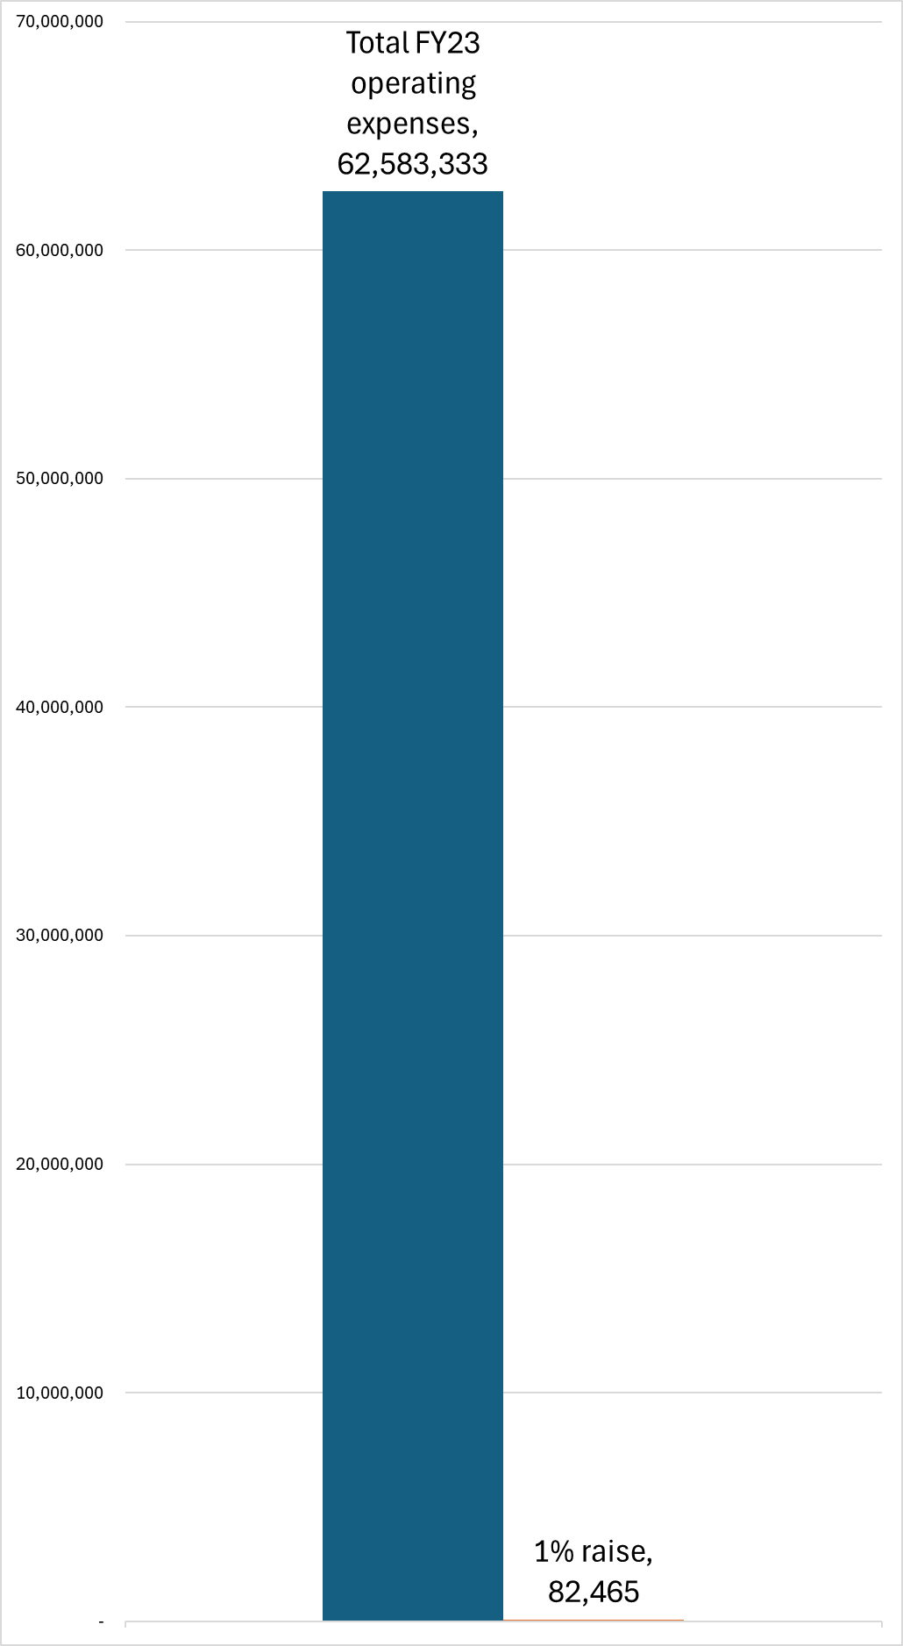
Each 1 percent increase in salary in the CBA = $82,465
Source: audited financial statements and salary data provided by the DelVal administration

Slide 41
The Business Case
Faculty serve the core mission of the institution
Tuition and fees are the main source of revenue at Delaware Valley
Faculty provide the education that generates tuition and fees
Faculty salary buying power has declined at an unsustainable rate
From a business perspective, investment in the education of students is essential to the present and future of the institution

Slide 42
College Closures and Reductions
Will the Delaware Valley FY24 audited financial statements contain a required disclosure statement of substantial doubt about the institution’s ability to continue as a going concern?
Do you anticipate the auditor will give a going concern opinion due to doubts about the financial sustainability of the institution in the FY24 financial statement audit?

Slide 43
Thank you

